Slide 1
Smartphone native LabVIEW applications
Now with extra Android and IOS

Slide 2
This presentation
Base application
Access system resources
Examples
Security
Interesting libraries

Slide 3
What is hacking?

Slide 4
What is hacking?
“a usually creatively improvised solution to a computer hardware or programming problem or limitation”
“a clever tip or technique for doing or improving something”
- Merriam Webster dictionary

Slide 5

Intro
Natan Biesmans
Full Stack web developer

Slide 6

Intro
Natan Biesmans
Full Stack web developer
CLA

Slide 7
Intro
Natan Biesmans
Full Stack web developer
CLA
Ex NI Employee

Slide 8
Intro
Natan Biesmans
Full Stack web developer
CLA
Ex NI Employee
LabVIEW R&D architect at QPLOX engineering
Outsourced to ASML as lead engineer

Slide 9
Base application: What is an application?
Runs native on the phone
Access to system resources
Thick client
Multi platform*
* Some system resources might be OS dependent.

Slide 10
Base application: Webview
Embed web pages
Notes:
Shift logic to webview instead of the base application, more flexible -> reason for Cordova

Slide 11
Base application: Webview
Embed web pages
Abstraction with base application and web page
Notes:
Shift logic to webview instead of the base application, more flexible -> reason for Cordova

Slide 12
Base application: Webview
Embed web pages
Abstraction with base application and web page
Web page can be multi platform
Notes:
Shift logic to webview instead of the base application, more flexible -> reason for Cordova

Slide 13
Base application: Webview
Embed web pages
Abstraction with base application and web page
Web page can be multi platform
Base application is platform specific
Notes:
Shift logic to webview instead of the base application, more flexible -> reason for Cordova

Slide 14
Base application: Webview
Embed web pages
Abstraction with base application and web page
Web page can be multi platform
Base application is platform specific
Shift logic to the webview instance
Notes:
Shift logic to webview instead of the base application, more flexible -> reason for Cordova

Slide 15
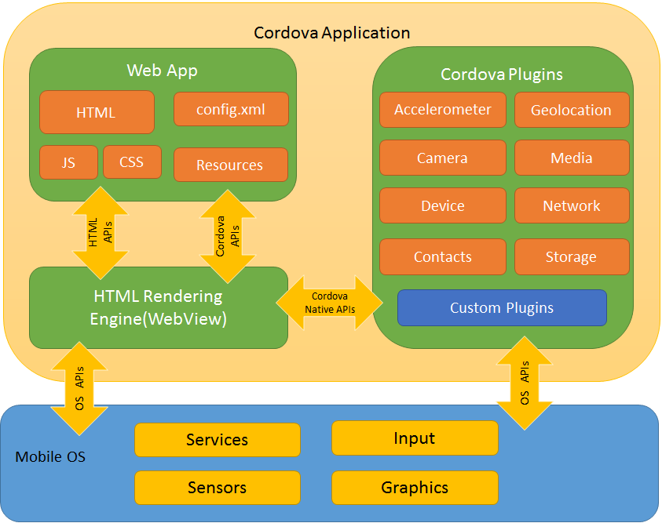
Base application: Cordova
Webview framework

Slide 16
Base application: Cordova
Webview framework
System access

Slide 17
Base application: Cordova
Webview framework
System access
Custom plugins

Slide 18
Base application: Cordova
Webview framework
System access
Custom plugins
Easy deployment

Slide 19
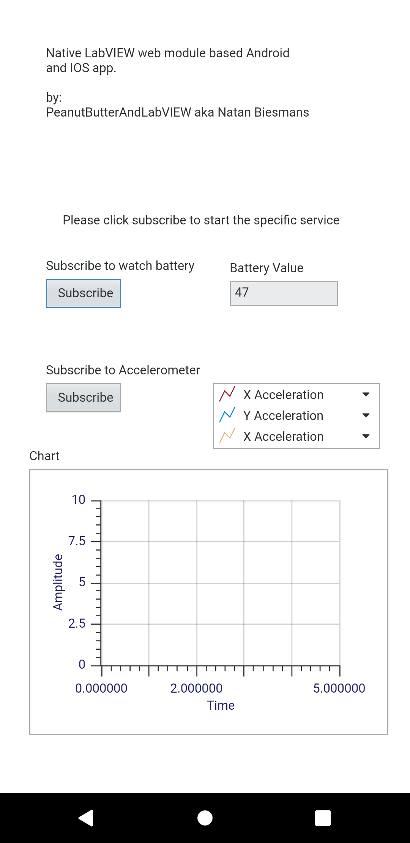
Creating an Application: The obvious way
Create a webvi page

Slide 20
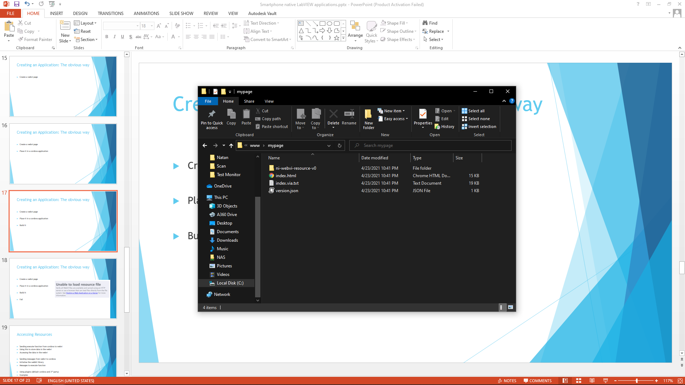
Creating an Application: The obvious way
Create a webvi page
Place it in a cordova application

Slide 21
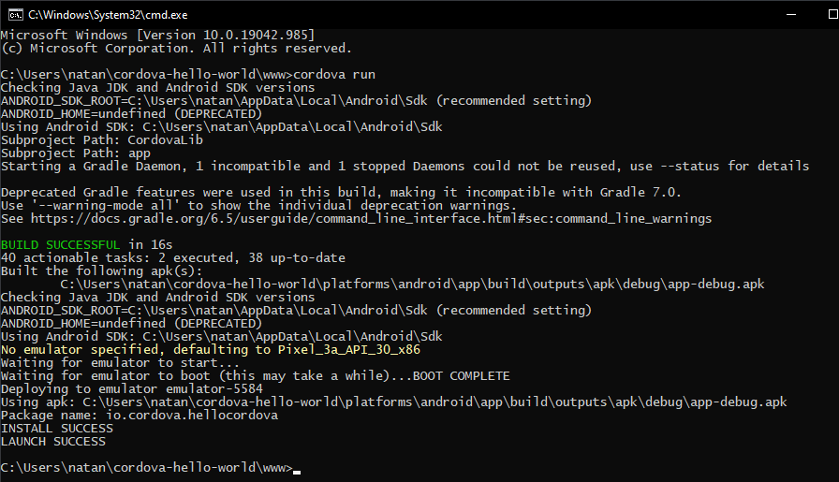
Creating an Application: The obvious way
Create a webvi page
Place it in a cordova application
Build it

Slide 22

Creating an Application: The obvious way
Create a webvi page
Place it in a cordova application
Build it
Fail

Slide 23
Creating an application: Serving the page
Add an HTTP server

Slide 24
Creating an application: Serving the page
Add an HTTP server
cordova plugin add cordova-plugin-httpd

Slide 25
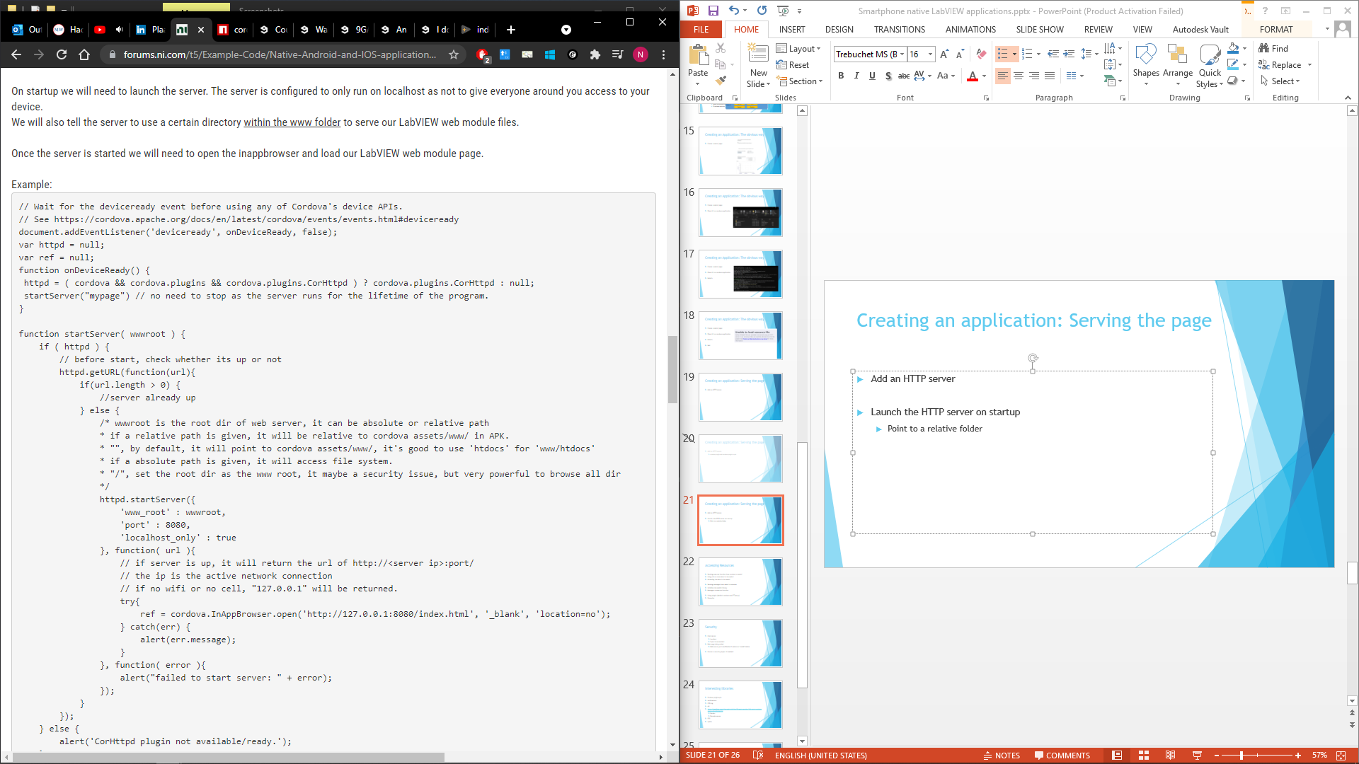
Creating an application: Serving the page
Add an HTTP server
Launch the HTTP server on startup
Point to a relative folder

Slide 26
Creating an application: Serving the page
Add an HTTP server
Launch the HTTP server on startup
Point to a relative folder

Slide 27
Creating an application: Serving the page
Add an HTTP server
Launch the HTTP server on startup
Point to a relative folder
Store the LabVIEW app in the folder

Slide 28
Creating an application: Serving the page
Add an HTTP server
Launch the HTTP server on startup
Point to a relative folder
Store the LabVIEW app in the folder
Add the inappbrowser

Slide 29
Creating an application: Serving the page
Add an HTTP server
Launch the HTTP server on startup
Point to a relative folder
Store the LabVIEW app in the folder
Add the inappbrowser
cordova plugin add cordova-plugin-inappbrowser

Slide 30
Creating an application: Serving the page
<?xml version='1.0' encoding='utf-8'?> <widget id="io.cordova.hellocordova" version="1.0.0"
xmlns="http://www.w3.org/ns/widgets"
xmlns:android="http://schemas.android.com/apk/res/android"
xmlns:cdv="http://cordova.apache.org/ns/1.0">
<name>LabVIEWonYourPhone</name> <description> Simple LabVIEW application for a mobile device. Tested on Android. </description> <author email="natan.biesmans@hotmail.com" href="https://www.linkedin.com/in/natan-biesmans-2875ab101/"> Natan Biesmans </author> <content src="index.html" /> <access origin="*" /> <allow-intent href="http://*/*" /> <allow-intent href="https://*/*" /> <allow-intent href="tel:*" /> <allow-intent href="sms:*" /> <allow-intent href="mailto:*" /> <allow-intent href="geo:*" /> <platform name="android"> <allow-intent href="market:*" /> <edit-config file="app/src/main/AndroidManifest.xml" mode="merge" target="/manifest/application"> <application android:usesCleartextTraffic="true" /> </edit-config> </platform> <platform name="ios"> <allow-intent href="itms:*" /> <allow-intent href="itms-apps:*" /> </platform> </widget>
Add an HTTP server
Launch the HTTP server on startup
Point to a relative folder
Store the LabVIEW app in the folder
Add the inappbrowser
Update config file

Slide 31
Creating an application: Serving the page
Add an HTTP server
Launch the HTTP server on startup
Point to a relative folder
Store the LabVIEW app in the folder
Add the inappbrowser
Update config file
Load the inappbrowser on server startup

Slide 32
Creating an application: Serving the page
Success!
Add an HTTP server
Launch the HTTP server on startup
Point to a relative folder
Store the LabVIEW app in the folder
Add the inappbrowser
Update config file
Load the inappbrowser on server startup

Slide 33
Accessing Resources
Receiving requests

Slide 34
Accessing Resources
Receiving requests
Sending Requests

Slide 35
Accessing Resources
Receiving requests
Sending Requests
Strategies

Slide 36
Accessing Resources
Receiving requests
Sending Requests
Strategies
Examples

Slide 37
Accessing Resources: Receiving requests
Inapp browser
Inappbrowser support bi-directional communication
LabVIEW
Code
Cordova
Code

Slide 38
Accessing Resources: Receiving requests
Inapp browser
Script to run
Inappbrowser support bi-directional communication
Execute a script in the browser
LabVIEW
Code
Cordova
Code

Slide 39
Accessing Resources: Receiving requests
Inappbrowser support bi-directional communication
Execute a script in the browser
ref.executeScript({ code: String_JS_Code});

Slide 40
Accessing Resources: Receiving requests
Inapp browser
String to run
Inappbrowser support bi-directional communication
Execute a script in the browser
Javascript is a scripting language
LabVIEW
Code
Cordova
Code

Slide 41
Accessing Resources: Receiving requests
Inapp browser
MyVar = 123
Inappbrowser support bi-directional communication
Execute a script in the browser
Javascript is a scripting language
Create a variable at runtime
LabVIEW
Code
Cordova
Code

Slide 42
Accessing Resources: Receiving requests
Inapp browser
MyVar = 123
Inappbrowser support bi-directional communication
Execute a script in the browser
Javascript is a scripting language
Create a variable at runtime
Store data in it
LabVIEW
Code
Cordova
Code

Slide 43
Accessing Resources: Receiving requests
Inapp browser
MyVar = 123
Inappbrowser support bi-directional communication
Execute a script in the browser
Javascript is a scripting language
Create a variable at runtime
Store data in it
Access the variable from LabVIEW
LabVIEW
Code
Cordova
Code

Slide 44
Accessing Resources: Sending requests
Inappbrowser support bi-directional communication

Slide 45
Accessing Resources: Sending requests
Inapp browser
Inappbrowser support bi-directional communication
Load the communication library
LabVIEW
Code
Cordova
Code

Slide 46
Accessing Resources: Sending requests
Inapp browser
Empty String
Inappbrowser support bi-directional communication
Load the communication library
Receive a request
LabVIEW
Code
Cordova
Code

Slide 47
Accessing Resources: Sending requests
Inapp browser
Empty String
Inappbrowser support bi-directional communication
Load the communication library
Receive a request
Send a message
LabVIEW
Code
Cordova
Code

Slide 48
Accessing Resources: Sending requests
Inapp browser
Empty String
Inappbrowser support bi-directional communication
Load the communication library
Receive a request
Send a message
webkit.messageHandlers.cordova_iab.postMessage(Message);
LabVIEW
Code
Cordova
Code

Slide 49
Accessing Resources: Strategy
Send command with data

Slide 50
Accessing Resources: Strategy
Send command with data
Rely on requests coming back

Slide 51
Accessing Resources: Strategy
Send command with data
Rely on requests coming back
Switching IDE’s

Slide 52
Accessing Resources: Strategy
Send command with data
Rely on requests coming back
Switching IDE’s
More secure

Slide 53
Accessing Resources: Strategy
Send command with data
Rely on requests coming back
Switching IDE’s
More secure
Send script to execute

Slide 54
Accessing Resources: Strategy
Send command with data
Rely on requests coming back
Switching IDE’s
More secure
Send script to execute
Send script code to execute

Slide 55
Accessing Resources: Strategy
Send command with data
Rely on requests coming back
Switching IDE’s
More secure
Send script to execute
Send script code to execute
Make the return request part of the code

Slide 56
Accessing Resources: Strategy
Send command with data
Rely on requests coming back
Switching IDE’s
More secure
Send script to execute
Send script code to execute
Make the return request part of the code
Easy for R&D

Slide 57
Accessing Resources: Strategy
Send command with data
Rely on requests coming back
Switching IDE’s
More secure
Send script to execute
Send script code to execute
Make the return request part of the code
Easy for R&D
Potentially insecure

Slide 58
Accessing Resources: Example Inspection Tool
Take image of a point of interest

Slide 59
Accessing Resources: Example Inspection Tool
Take image of a point of interest
Send to a systemlink server

Slide 60
Accessing Resources: Example Inspection Tool
Take image of a point of interest
Send to a systemlink server
Review later

Slide 61
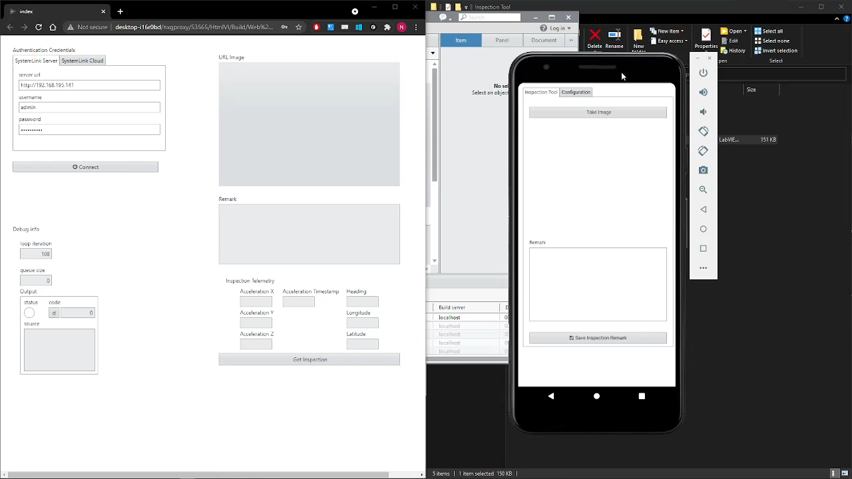
Accessing Resources: Example Inspection Tool

Slide 62
Accessing Resources: Example Test monitor
Monitor the state of a test bench on systemlink

Slide 63
Accessing Resources: Example Test monitor
Monitor the state of a test bench on systemlink
Update state changes

Slide 64
Accessing Resources: Example Test monitor
Monitor the state of a test bench on systemlink
Update state changes
Visualize as a notification

Slide 65
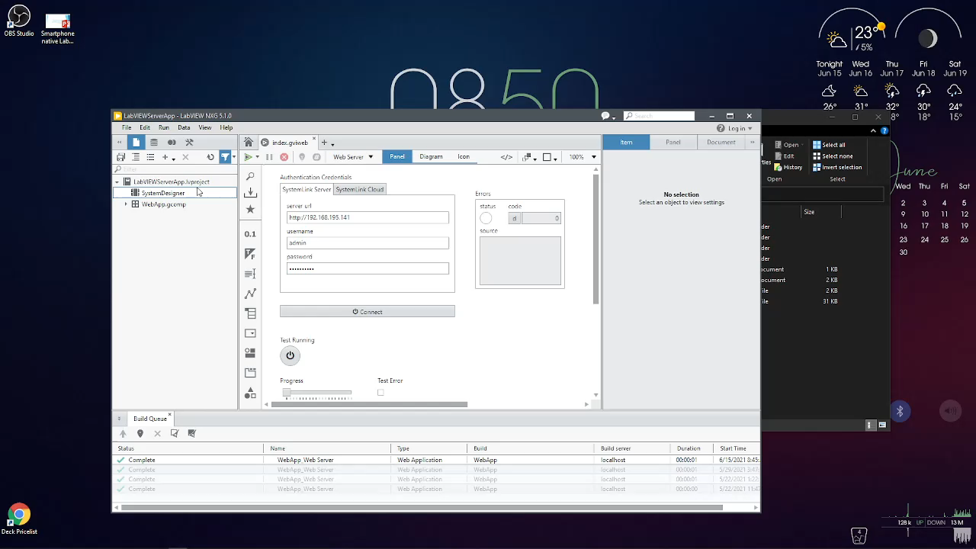
Accessing Resources: Example Test monitor

Slide 66
Security
HTTP server

Slide 67
Security
HTTP server
Localhost

Slide 68
Security
HTTP server
Localhost
If port in use, use another

Slide 69
Security
HTTP server
Localhost
If port in use, use another
Web page being called

Slide 70
Security
HTTP server
Localhost
If port in use, use another
Web page being called
Make sure to put in verification if used on an “unsafe” device.

Slide 71
Security
HTTP server
Localhost
If port in use, use another
Web page being called
Make sure to put in verification if used on an “unsafe” device.
Contact a security expert if needed!

Slide 72
Interesting libraries
Cordova plugin apis
notifications
USB otg
AR
FTP
SQLLITE
https://medium.com/the-web-tub/the-10-most-popular-3rd-party-cordova-plugins-8c443d4a615e
Version
Barcode scanner

Slide 73
What is hacking?
“a usually creatively improvised solution to a computer hardware or programming problem or limitation”
“a clever tip or technique for doing or improving something”
- Merriam Webster dictionary

Slide 74
What is hacking?
Our duty

Slide 75
Resources
Cordova installation guide
https://www.tomspencer.dev/blog/2017/05/30/a-guide-to-installing-cordova-on-windows-10/
My github
https://github.com/NatanBiesmans
My NI Guide
https://forums.ni.com/t5/Example-Code/Native-Android-and-IOS-applications-with-LabVIEW-web-modules/ta-p/4145399?profile.language=en

